Slide 1

Adolescent Obesity Prediction System
Presented by:
k.Hemanth
Under the Guidance of
&
‘
Assistant professor
Department of

Slide 2
Outline
ABSTRACT
INTRODUCTION
LITERATURE REVIEW
OBJECTIVE
EXISTING METHOD
PROPOSED METHOD
HARDWARE & SOFTWARE INVOLVED
ADVANTAGES AND APPLICATION
REFERENCES
PROJECT VIVA-VOCE

Slide 3
Abstract
The global prevalence of childhood and adolescent obesity is a major concern due to its association with chronic diseases and long-term health risks. Artificial intelligence technology has been identified as a potential solution to accurately predict obesity rates and provide personalized feedback to adolescents. This study highlights the importance of early identification and prevention of obesity-related health issues. To develop effective algorithms for the prediction of obesity rates and provide personalized feedback, factors such as height, weight, waist circumference, calorie intake, physical activity levels, and other relevant health information must be taken into account. Therefore, by collecting health datasets from 321 adolescents who participated in Would You Do It! application, we proposed an adolescent obesity prediction system that provides personalized predictions and assists individuals in making informed health decisions. Our proposed deep learning framework, Deep Health Net, effectively trains the model using data augmentation techniques, even when daily health data are limited, resulting in improved prediction accuracy (acc: 0.8842). Additionally, the study revealed variations in the prediction of the obesity rate between boys (acc: 0.9320) and girls (acc: 0.9163), allowing the identification of disparities and the determination of the optimal time to provide feedback. Statistical analysis revealed that the performance of the proposed deep learning framework was more statistically significant (p<0.001) compared to the other general models. The proposed system has the potential to effectively address childhood and adolescent obesity.

Slide 4
Introduction
Obesity has emerged as one of the most pressing global health challenges, affecting millions of adolescents worldwide. It is closely linked to an increased risk of chronic diseases, such as diabetes, cardiovascular conditions, and certain types of cancer. The rising prevalence of obesity among young individuals poses a significant threat to their immediate and long-term health, making early intervention and prevention crucial.
In recent years, the rapid advancement of machine learning (ML) technologies has paved the way for more effective and personalized healthcare solutions. Specifically, predictive modeling has the potential to significantly enhance the early detection of obesity risk, enabling timely interventions that can help prevent the onset of related health complications. Traditional methods of obesity risk assessment, which often rely on self-reported data or limited clinical measurements, may not provide the comprehensive insights needed to effectively manage and prevent obesity.
This project introduces a novel machine learning-based approach to predict obesity risk in adolescents using two powerful classification models: the XGBoost Classifier and the Stacking Classifier. Both models are well-suited to handle complex, high-dimensional datasets, allowing for highly accurate predictions based on various physical, demographic, and lifestyle attributes. The use of these advanced models is aimed at improving the precision of obesity risk assessments, offering personalized feedback that can inform healthcare decisions and behavioral interventions.

Slide 5
The dataset used in this study contains 2,111 instances with 17 attributes, representing factors such as body mass index (BMI), physical activity levels, dietary habits, and other relevant health indicators. By training the machine learning models on this dataset, the system classifies individuals into various obesity risk categories, enabling healthcare professionals to identify at-risk individuals and take preventative measures.
In addition to the core machine learning models, this project integrates a user-friendly web application, built with Python and Flask, to provide a seamless and interactive interface. This platform allows users—whether healthcare professionals or individuals seeking to assess their own obesity risk—to input relevant data and receive immediate, data-driven feedback.
By combining cutting-edge machine learning techniques with accessible technology, this obesity prediction system has the potential to play a significant role in global efforts to combat obesity. It offers a scalable, accurate, and efficient solution for identifying at-risk adolescents, facilitating early interventions, and promoting healthier lifestyle choices.

Slide 6
Literature Survey
Obesity Prediction Models
Traditional approaches for predicting obesity risk often rely on basic physical metrics such as body mass index (BMI), waist circumference, and age. While these methods provide a basic understanding of obesity risk, they fail to capture the complexity of the issue. More recent studies have employed machine learning algorithms to create predictive models that can consider a wider range of variables, including dietary habits, physical activity levels, and genetic factors.
Several studies have explored the use of machine learning techniques such as decision trees, support vector machines (SVM), and neural networks for predicting obesity. For example, a study by Mounika et al. (2020) applied decision trees to predict obesity risk in children and adolescents, achieving an accuracy of 88%. Similarly, a study by Singh et al. (2021) demonstrated the use of SVM for classifying obesity risk in a large dataset, achieving high classification accuracy based on factors like age, gender, and BMI.

Slide 7
Deep Learning in Obesity Prediction
While traditional machine learning models have shown promise, more sophisticated techniques such as deep learning have been explored in recent years to improve prediction accuracy. Deep learning models, particularly those based on neural networks, are capable of handling large and complex datasets, making them well-suited for obesity prediction tasks. A deep learning model called DeepHealthNet was developed by Jeong et al. (2024) to predict adolescent obesity, achieving a remarkable accuracy of 88.42%. This model was trained using data from various health-related attributes, including BMI, physical activity, and calorie intake, and was able to provide personalized predictions with a high degree of reliability. The study also revealed that the model's performance varied between boys and girls, highlighting the importance of gender-specific predictions.
Another significant contribution to the field is the use of convolutional neural networks (CNNs) in obesity prediction. CNNs, which are primarily used in image recognition tasks, have also been adapted for health data, especially when combined with other machine learning techniques. This integration of CNNs with other models enables the system to improve predictions by learning from both structured and unstructured data.

Slide 8
Objective
The primary objective of this project is to develop a machine learning-based system for accurately predicting obesity risk in adolescents. This system leverages two advanced classification models—XGBoost Classifier and Stacking Classifier—to enhance prediction accuracy based on a wide range of physical, lifestyle, and demographic factors. The specific objectives of this project are as follows:
Obesity Risk Prediction: To design and implement an automated system that predicts obesity risk in adolescents using machine learning algorithms. The system will classify individuals into various obesity categories based on factors such as body mass index (BMI), physical activity levels, eating habits, age, and other relevant health metrics.
Integration of Advanced Classification Models: To explore the use of advanced machine learning techniques, specifically the XGBoost Classifier and Stacking Classifier, to improve the accuracy of obesity predictions. By combining the strength of individual models, the system aims to provide a more robust and reliable prediction compared to traditional approaches.
Accuracy Optimization: To achieve high classification accuracy in both training and testing phases, ensuring that the obesity risk predictions are precise and reliable. The project seeks to optimize the system’s ability to handle large and complex datasets, ensuring that predictions are not only accurate but also generalizable across different adolescent populations.

Slide 9
Existing Method
Data Availability and Quality: Many obesity prediction systems rely on datasets that may be small, unbalanced, or lack sufficient diversity to generalize across populations. Additionally, missing data and inaccuracies in self-reported information can compromise model performance.
Accuracy and Interpretability: While some machine learning models, such as deep learning networks, show promising results, their lack of transparency (i.e., “black-box” nature) makes it difficult for healthcare professionals to trust and understand the predictions. Moreover, accuracy tends to vary across different populations, which may require models to be trained on specific demographic groups.
Personalization: Current systems often fail to deliver highly personalized recommendations. Adolescent obesity risk factors are influenced by a wide range of individual variables, including genetic predisposition, family history, and socio-economic conditions. Most existing systems lack the ability to dynamically adapt to these factors, limiting their ability to provide tailored health interventions.
Real-Time and Dynamic Feedback: Most obesity prediction models provide one-time assessments, which are often static and not responsive to ongoing changes in an individual's lifestyle. Real-time health monitoring and prediction are critical for early detection and ongoing management of obesity, especially in the adolescent population where habits may change rapidly.

Slide 10
Proposed Method
Data Cleaning
Handle missing or inconsistent data by:
Imputing missing values (mean, median, or mode for numeric; most frequent for categorical).
Removing duplicates.
Normalize or standardize numerical features for models sensitive to feature scaling.
1.2. Feature Engineering
Create new features (e.g., BMI derived from height and weight, calorie-to-activity ratio).
Encode categorical variables using techniques like one-hot encoding or label encoding.
1.3. Feature Selection
Analyze feature importance using methods like:
Correlation matrices for linear dependencies.
Tree-based feature importance (e.g., using XGBoost).
Drop redundant or low-importance features.

Slide 11
2. Model Development
2.1. Machine Learning Models
XGBoost Classifier: A powerful gradient boosting algorithm optimized for speed and accuracy, suitable for handling structured data.
Stacking Classifier: Combines predictions from multiple base classifiers to enhance overall model performance.
Base models: Random Forest, Logistic Regression, Support Vector Machines (SVM), etc.
Meta-model: Logistic Regression for combining base model outputs.
2.2. Hyperparameter Tuning
Use techniques like Grid Search or Bayesian Optimization to fine-tune model parameters for:
Learning rate
Maximum depth
Number of estimators
Regularization parameters
2.3. Evaluation Metrics
Accuracy, Precision, Recall, F1-Score, ROC-AUC for classification performance.
Perform k-fold cross-validation for generalization assessment.
3. Implementation
3.1. Backend

Slide 12
Coding Language: Python 3.12.0.
Framework: Flask for API creation and deployment.
Models: Train and save XGBoost and Stacking classifiers using libraries like Scikit-learn and XGBoost.
3.2. Frontend
Technology: HTML, CSS, JavaScript.
Features:
Intuitive interface for users to input health and lifestyle data.
Display prediction results and risk categories.
Provide actionable recommendations based on predictions.
3.3. Integration
Connect backend ML models with the frontend using Flask APIs.
Ensure seamless data flow and efficient performance.
4. System Testing
Conduct unit tests, integration tests, and end-to-end tests to ensure functionality.
Validate the web interface usability.
5. Deployment
Deploy the system on a cloud platform like AWS, Azure, or Google Cloud for scalability and availability.
Ensure secure data handling and compliance with relevant health data privacy standards (e.g., GDPR, HIPAA).

Slide 13
Explanation
Existing Methods for Adolescent Obesity Prediction
Several methods are currently employed to predict and manage adolescent obesity. These methods typically rely on traditional statistical approaches, simpler machine learning models, or manual assessment. Below are some common approaches and their limitations:
1. Traditional Approaches
1.1. Body Mass Index (BMI) Classification
Description: BMI, calculated as weight (kg) divided by height squared (m²), is a widely used metric for classifying obesity.
Limitations:
Does not account for muscle mass, bone density, or fat distribution.
Limited predictive capability as it fails to incorporate other lifestyle or health factors.
1.2. Waist-to-Height Ratio (WHtR)
Description: Ratio of waist circumference to height is used as a predictor of obesity and cardiovascular risk.
Limitations:

Slide 14
Provides only a partial picture of overall health and obesity risk.
1.3. Questionnaires and Surveys
Description: Self-reported data on diet, physical activity, and lifestyle habits are analyzed to assess obesity risk.
Limitations:
Subject to bias and inaccuracies due to reliance on self-reported information.
2. Basic Machine Learning Models
2.1. Logistic Regression
Description: A statistical model used for binary classification of obesity (e.g., obese vs. non-obese).
Limitations:
Limited to linear relationships between variables.
Performance degrades when dealing with complex, non-linear interactions.
2.2. Decision Trees
Description: Used for classifying individuals into different obesity categories based on threshold values of input features.
Limitations:
Prone to overfitting with small datasets.
Less effective for large, complex datasets compared to ensemble methods.
2.3. Support Vector Machines (SVM)
Description: Used for binary or multi-class classification based on margin maximization.

Slide 15
Proposed Work
Machine Learning Framework
Models
XGBoost Classifier
Gradient boosting algorithm known for high accuracy and efficiency in handling structured data.
Feature importance analysis for better interpretability.
Stacking Classifier
Combines predictions from multiple base models (e.g., Random Forest, Logistic Regression, SVM).
Uses a meta-model (Logistic Regression) to improve overall performance.
. Model Training
Split the dataset into training (80%) and testing (20%) sets.
Use data augmentation techniques to address class imbalances, if present.
Perform hyperparameter tuning using Grid Search or Randomized Search.
4.3. Evaluation Metrics
Classification Metrics: Accuracy, Precision, Recall, F1-Score, ROC-AUC.
Validation Methodology: K-fold cross-validation to ensure generalization.

Slide 16
Hardware & Software Involved
HARDWARE REQUIREMENTS:
System : Pentium i3 Processor.
Hard Disk : 500 GB.
Monitor : 15’’ LED.
Input Devices : Keyboard, Mouse.
Ram : 8 GB.
SOFTWARE REQUIREMENTS:
Operating System : Windows 10 / 11.
Coding Language : Python 3.12.0.
Web Framework : Flask.
Frontend : HTML, CSS, JavaScript.

Slide 17
Application & Advantages
Application :
Community Health Programs
Used by public health agencies to track obesity trends in communities and design targeted interventions.
Fitness and Wellness Industry
Incorporated into fitness apps and programs to provide users with personalized diet and exercise recommendations.
Advantages:
Early Detection of Obesity Risk
Provides timely identification of individuals at risk of obesity, enabling early intervention and prevention strategies.
High Prediction Accuracy
Advanced machine learning models (XGBoost and Stacking Classifier) ensure precise predictions with accuracy rates of up to 98%, reducing false positives and negatives.
Personalized Feedback
Offers tailored health recommendations based on individual risk profiles, promoting better health outcomes.

Slide 18
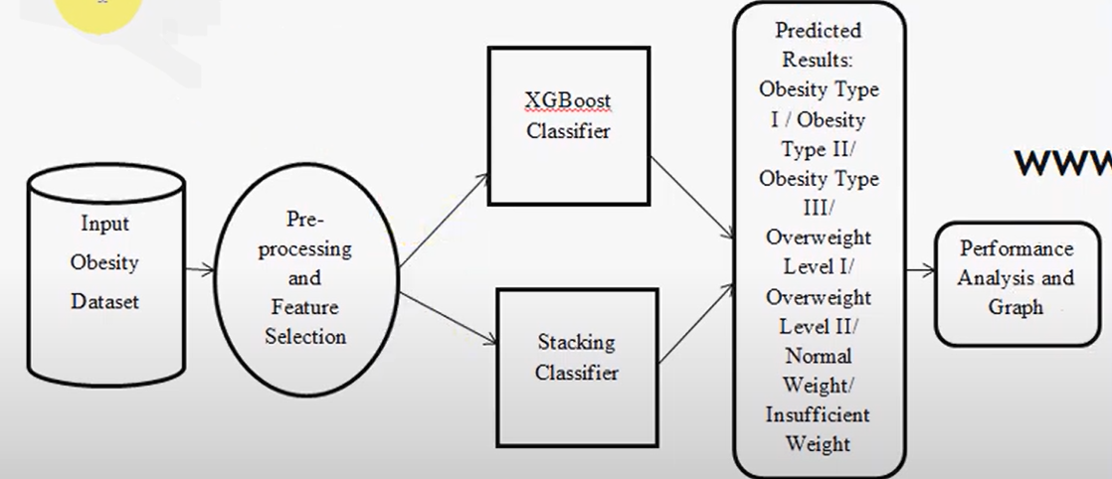























































System Architecture/Proposed work Block diagram

Slide 19
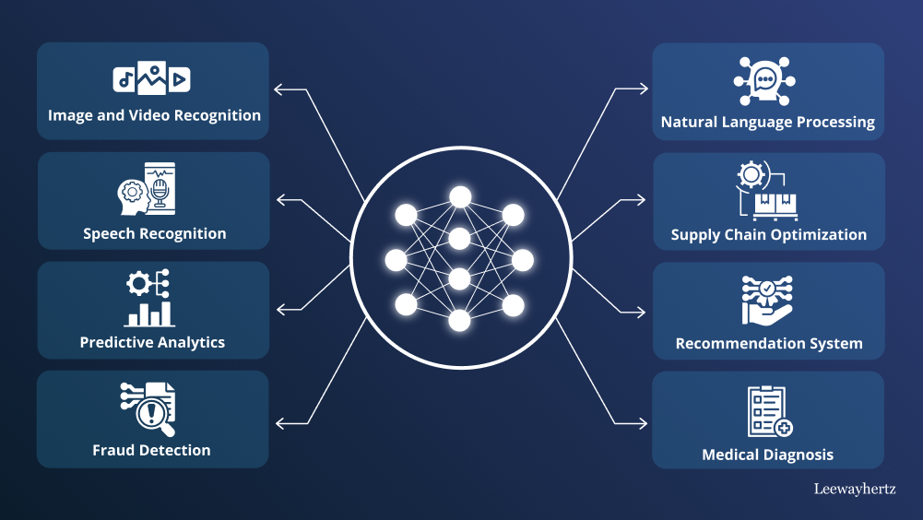
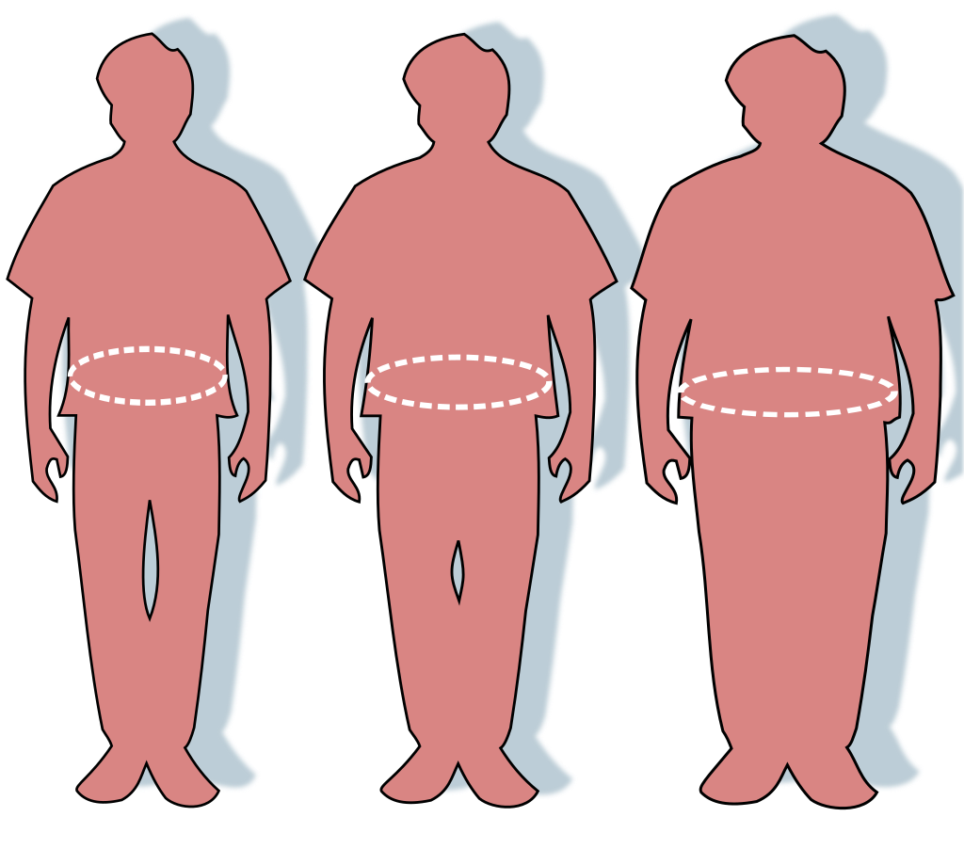
UML Diagrams

Slide 20
References
Ji-Hoon Jeong, Associate Member, IEEE, In-Gyu Lee , Sung-Kyung Kim , Tae-Eui Kam, Seong-Whan Lee , Fellow, IEEE, and Euijong Lee,
Deep Health Net: Adolescent Obesity Prediction System Based on a Deep Learning Framework.
IEEE JOURNAL OF BIOMEDICAL AND HEALTH INFORMATICS, VOL. 28, NO. 4, APRIL 2024.

Slide 21
THANK YOU

